Slide 1

Secret Ingredients for Falling in Love the Second Date
An analysis on the Speed Dating dataset from Kaggle: https://www.kaggle.com/annavictoria/speed-dating-experiment

Slide 2
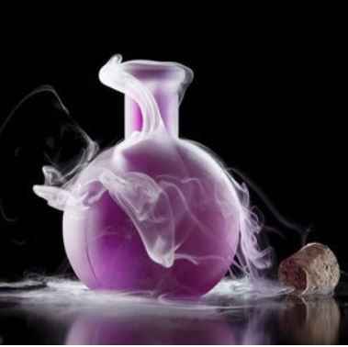
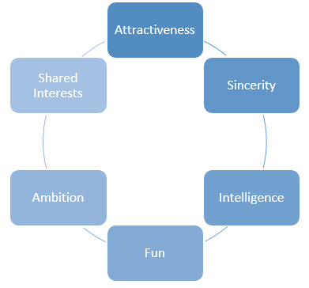
Taking steps is easy Standing still is hard... Everything is different The second time around. Regina Spektor
What influences love at first sight? (Or, at least, love in the first four minutes?) This dataset was compiled by Columbia Business School professors Ray Fisman and Sheena Iyengar for their paper Gender.
Data was gathered from participants in experimental speed dating events from 2002-2004. During the events, the attendees would have a four minute "first date" with every other participant of the opposite sex. At the end of their four minutes, participants were asked if they would like to see their date again. They were also asked to rate their date on six attributes:
The dataset also includes questionnaire data gathered from participants at different points in the process. These fields include: demographics, dating habits, self-perception across key attributes, beliefs on what others find valuable in a mate, and lifestyle information.

Slide 3
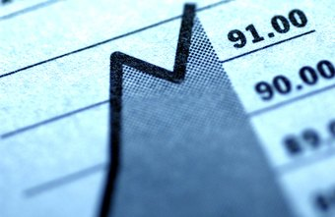
Table of Contents I. Clean Dataset : Speed_Dating II. Desciptive Dataset : Speed_Dating III. Deep dive in love IV. Conclusion SIDI AND Emilien

Slide 4
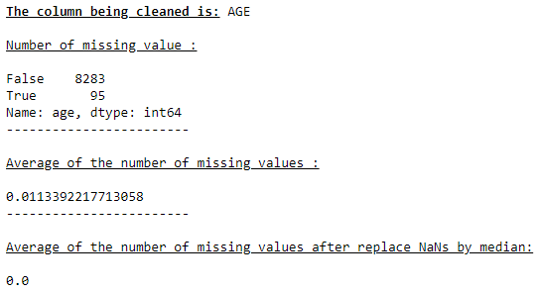
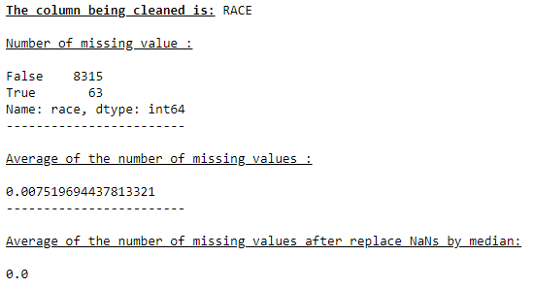
I. Clean Dataset : Speed_Dating
Example :
Age = NaN => 95 ; Race = NaN => 63 ; Income = NaN => 4099 ; Career= NaN => 138 ;
For income : average of missing values is 48,9%

Slide 5
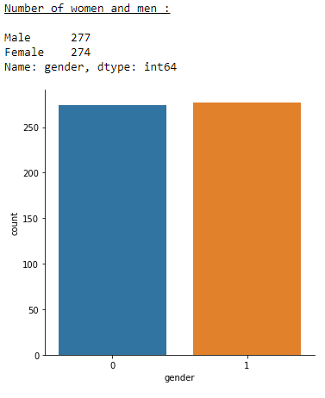
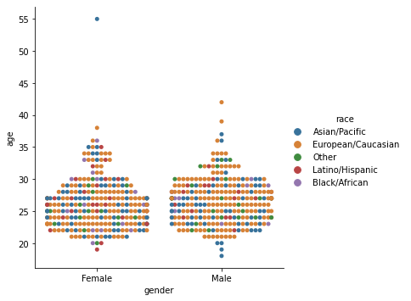
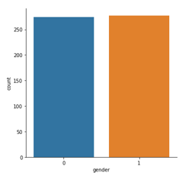

II. Desciptive Dataset : Speed_Dating
Breakdown by genre, age and race :

Slide 6
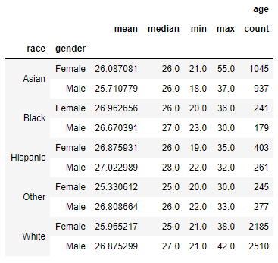
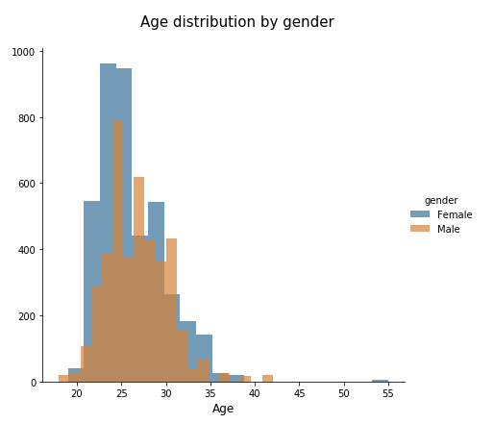
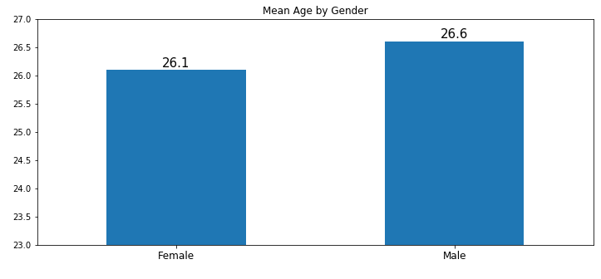
II. Desciptive Dataset : Speed_Dating
Distribution de l'âge

Slide 7
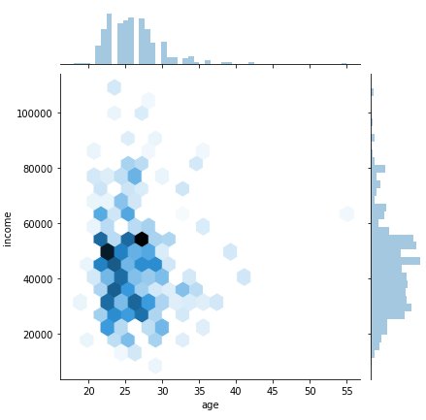
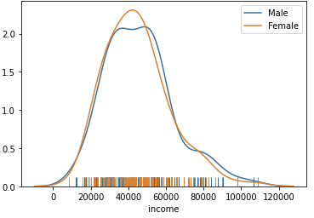
II. Desciptive Dataset : Speed_Dating
Breakdown by income and race :
Breakdown by income and age :

Slide 8
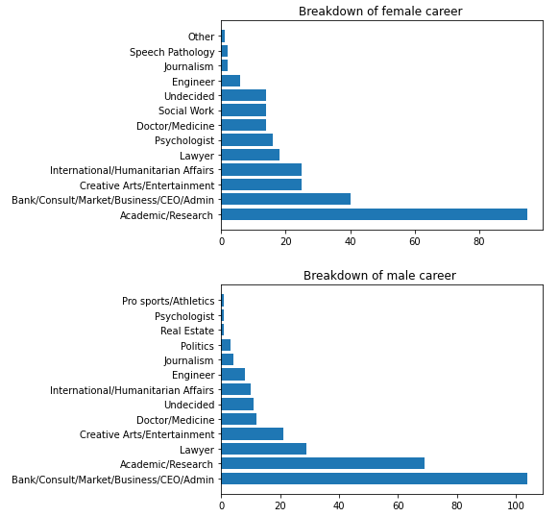
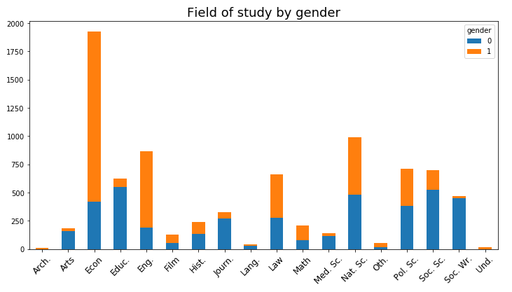
II. Desciptive Dataset : Speed_Dating

Slide 9
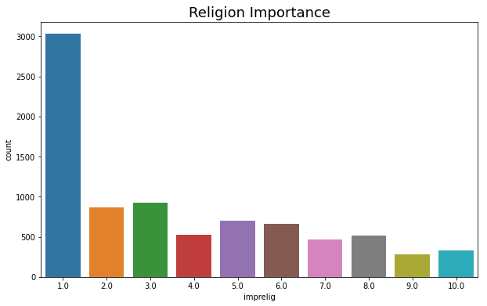
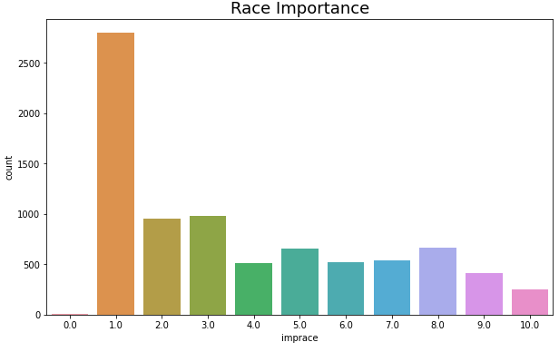
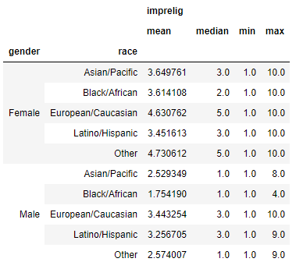
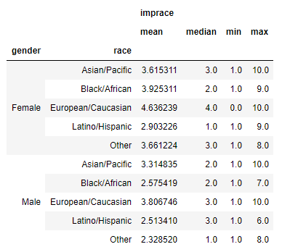
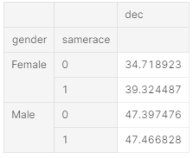
II. Desciptive Dataset : Speed_Dating
Influence of the Same Religion
Importance of sharing the same racial/ethnic origin?

Slide 10
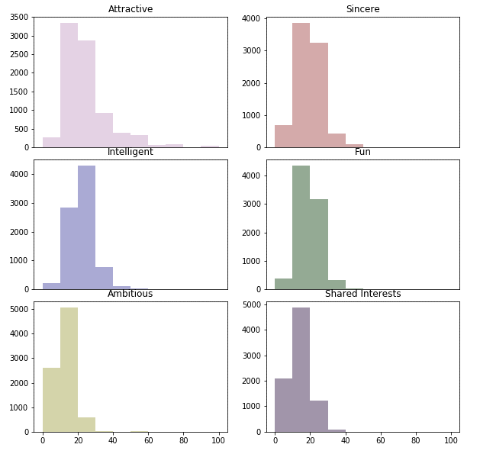
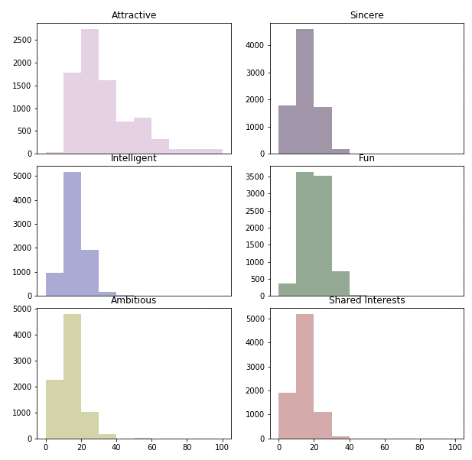
III. Deep dive in love
What does a person looks for in a partner ?
What does a person thinks that their partner would look for ?

Slide 11
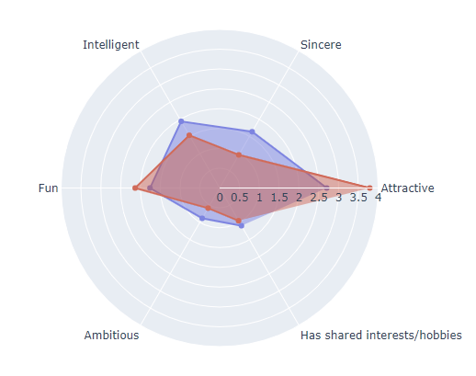
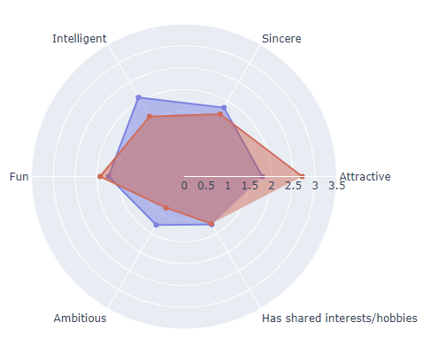
III. Deep dive in love PREFERENCE VERSUS REALITY
6 factor Profiles for male before and after if match = yes:
6 factor Profiles for female before and after if match = yes:

Slide 12
iv. Conclusion
What we learn?
What we can say?
Why we need more time to do machine learning analysis?

Slide 13
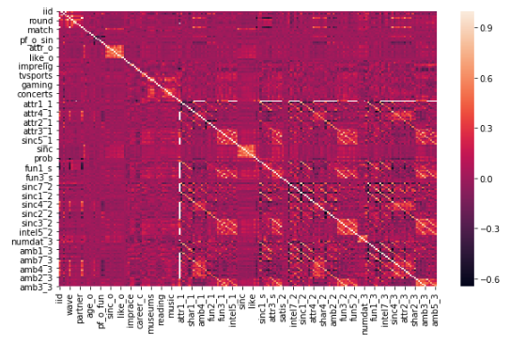
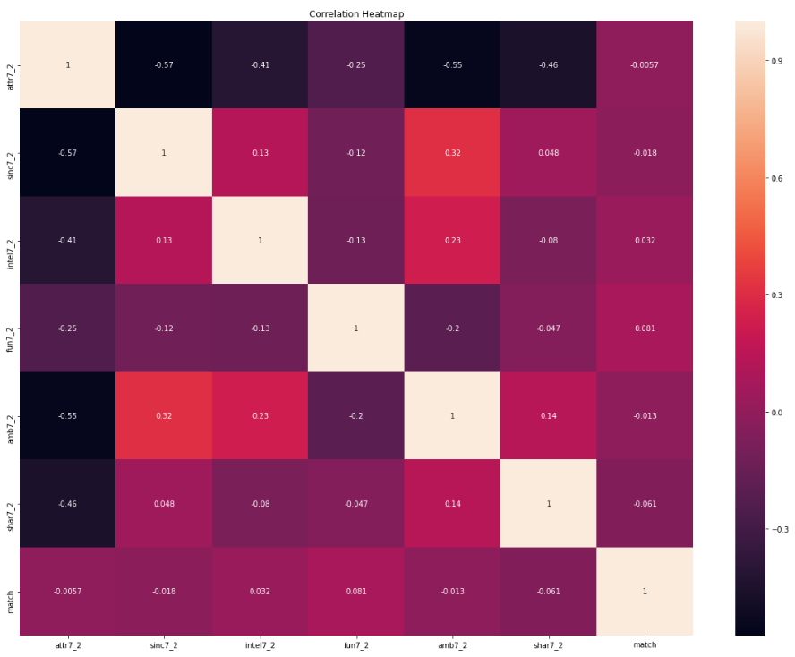

TEST

